Slide 1
ENTREPRENEURSHIP
Lecture No: 28
Resource Person:
Malik Jawad Saboor
Assistant Professor
Department of Management Sciences
COMSATS Institute of Information Technology
Islamabad.

Slide 2

OBJECTIVES
Define Elevator Pitch
Elevator Pitch Must Haves & Cautions
Elements of Pitch
Dragon’s Den Video

Slide 3
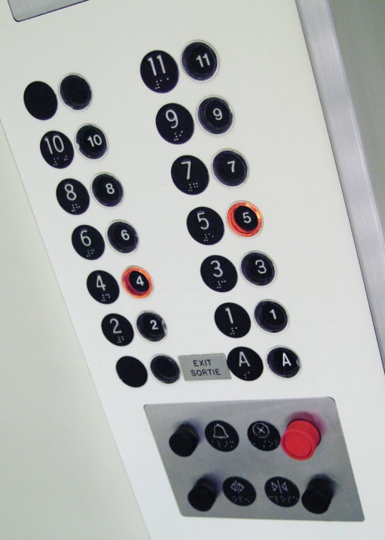
What is an Elevator Pitch?
A short, simple description of your business idea that anyone could understand by the time you ride up three floors in a typical elevator.

Slide 4

Very Important Point
An elevator pitch is not a sales pitch
It is NOT a pitch of a great idea, team or product
You ARE pitching what your business will do for customers, investors, and/or society
You want to pitch how your business solves a real problem or addresses a burning need that exists today

Slide 5


Elevator Pitch “Must Haves” and Caution
Interesting opening: opening much immediately grab interest of recipient
Passion: if you are not excited about your idea, no one else will be
Short: you only have one minute deliver your pitch
Caution: Do not take too long to get to the pain/problem that you are solving—you could lose the listener’s attention

Slide 6
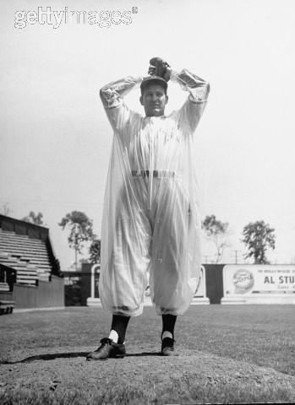
Elements of the Pitch
The following points are included in effective elevator pitches
The Hook: pitch opening that grabs the listener's attention
Brief description of product/service
Brief target market description
Brief description of how the business is different from the competition
Brief description of how you will make money
Brief description of the resources you need from investors
Brief description of the returns/payback the investor can expect
Memorable tagline/pitch closing

Slide 7
The Hook/Pitch Opening
The hook should grab the attention of the listener and set the stage for the concept
Many ways to do this including identifying the problem/need you address
We help resolve the housing crisis
If possible, help your listener relate to the problem
Questions can be effective: Have you ever had your cell phone fail inside a building?
Very brief personal stories can also be effective openers

Slide 8
Product/Service Pitch
Guidelines to keep in mind when developing the product pitch:
KISS – Keep It Simple, Stupid
Limit technical terms/details
Highlight customer benefits, not technical benefits

Slide 9
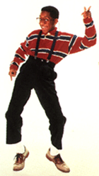
Geek speak: Listeners Tune Out What They don’t Understand
INEFFECTIVE:
We provide non-penetrable debridement medical equipment technologies for lymph node excision by integrating our with our 4851-bit encryption algorithm that is integrated with the newest 245-bit Dorland operators.
EFFECTIVE:
We allow medical professionals to operate on cancer patients using the least invasive equipment on the market.

Slide 10


Customer Benefits, Not Technical Benefits
Technical Benefits
Business Benefits
Unmatched assimilation
Dimensional attributes
Largest system adaptability
SO WHAT???
Increase your sales
Increase your efficiency
Cut your costs by 25%

Slide 11
Target Market Description: Relate to a Need
Identify the problem solved or need addressed in a sentence or two
We allow any wireless technology to work inside any building that utilizes our wireless networking product
If possible, mention a customer who uses your product or that has expressed interest
The FAA has determined that we are the only system that can quickly screen people at security check points while also exceeding their security needs
If you do not have existing customers, quantify the size of the market you will target using numbers from a reputable source
According to the American Cancer Society, there are 5,000 hospitals in the U.S. that need the updated radiology equipment

Slide 12
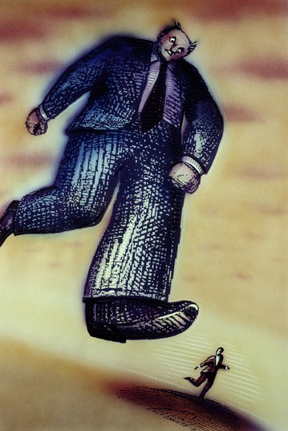
Acknowledge Your Competition
Apple
You

Slide 13
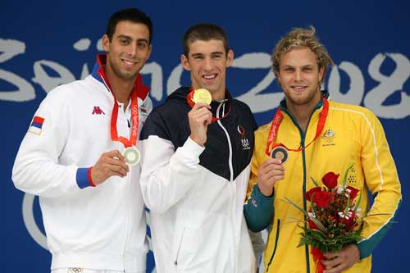
Briefly Acknowledge Your Competition
Identify a couple of your competitors as well as what they provide
There are many vendors that provide internal wireless networks like Linksys and Cisco.
While no other firms offer a service package as comprehensive as ours, companies like PetSmart do offer some pet daycare and grooming options.

Slide 14
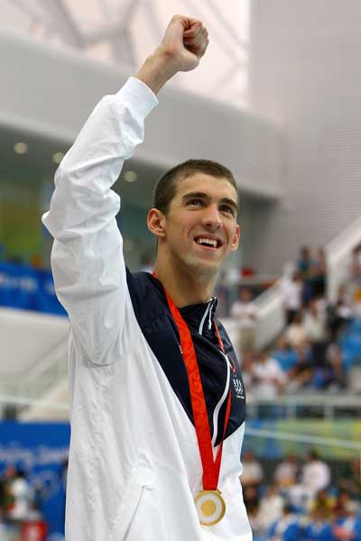
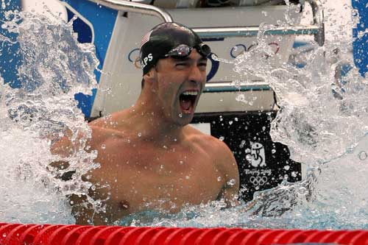
Neutralize Your Competition
Describe one or two differentiators that describe your advantage
Unlike the competitors, our firm offers customers a full-service pet daycare, grooming services, and a pet training facility that is run by world-class trainers.

Slide 15

Describe How you Make Money
Describe your firm’s revenue model (e.g., how your firm earns its money)
For grooming, customers will pay for the services rendered and for pet training and daycare, customers will have the option of different service-level packages.
We will distribute and sell our products through big box retailers as well as directly through our online store
We will license our technology to companies like Widgets Corp. to integrate into their existing digital cameras

Slide 16

Investor Requirements and Returns
Describe the investment required at this stage of the business planning process
Describe for what purpose(s) that money will be used
Describe how, when, and with what rate of return you expect to payback investors
We are seeking $500,000 in initial start-up capital to fund prototype refinement, initiate initial marketing efforts, and website development. Based on our sales estimates, we plan to pay investors back 30% in year one at 20% ROI and 70% in year two at 30% ROI.
We are seeking a $1,500,000 investment to fund manufacturing, marketing, and initial product distribution. Within five years, we seek to achieve an IPO, at which time investors can expect a payback at about a 20% ROI.

Slide 17
Tagline/Pitch Closing
End the pitch in a memorable way
Taglines are often very effective:
In sum, GE brings good things to light
Acura—the road will never the same
Harley Davidson: American by birth. Rebel by choice.
In conclusion IBM provide solutions for a small plant
If you do not have a tagline, closing the pitch with a simple “Thank You” can also be effective and professional

Slide 18
Elevator Pitch: An Example
Hook: Have you ever had your cell phone fail inside a building?
Product: We provide a wireless communications network that enables any cell phone to work anywhere inside all types buildings, while ensuring your communications are secure.
Market: The FCC has determined that over 60% of the 5 million commercial buildings in the U.S. inhibit wireless or cell phone communications from within. The percentage is even higher in international markets, suggesting a huge need for better wireless communications networks.
Competition and Differentiators: There are many vendors that provide internal wireless networks like Linksys and Cisco. However, we are the only vendor that enables communications to penetrate steel and other high density construction materials, which significantly reduces the cost of installation
Revenue Model: We will install the wireless network in a building at no charge, and then charge a usage fee for all calls that we carry on our networks
Investment Required and Payback Estimate: We are seeking a $1,500,000 investment to fund manufacturing, marketing, and initial product distribution. Within five years, we seek to achieve an IPO, at which time investors can expect a payback at about a 20% ROI.
Closing: In conclusion, we make wireless communication simple and effective.

Slide 19


